Slide 1
CAMARA – MEC & Deployment API
July 2022

Slide 2
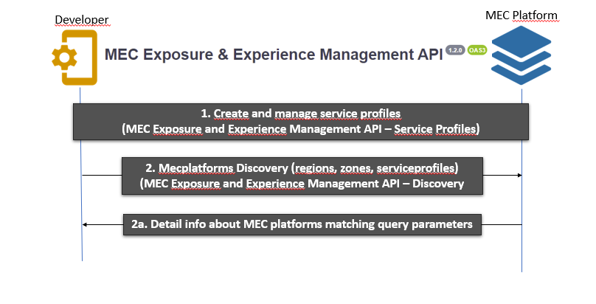
Flow Analysis – Discovery Phase

Slide 3
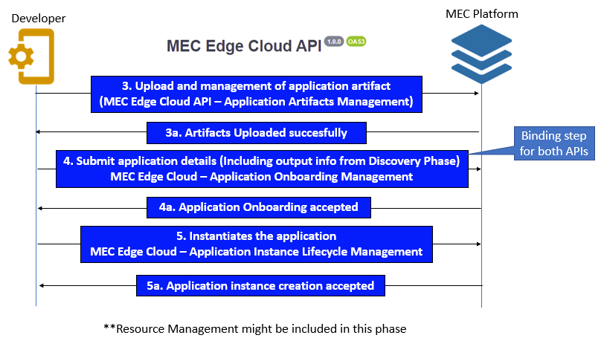
Flow Analysis – Application Onboarding Phase

Slide 4
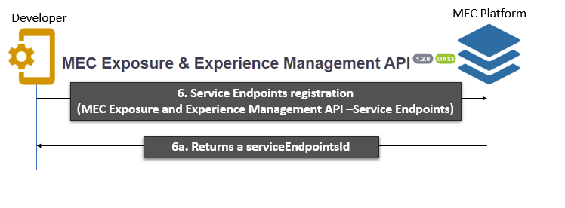
Flow Analysis – Service Endpoints Phase

Slide 5
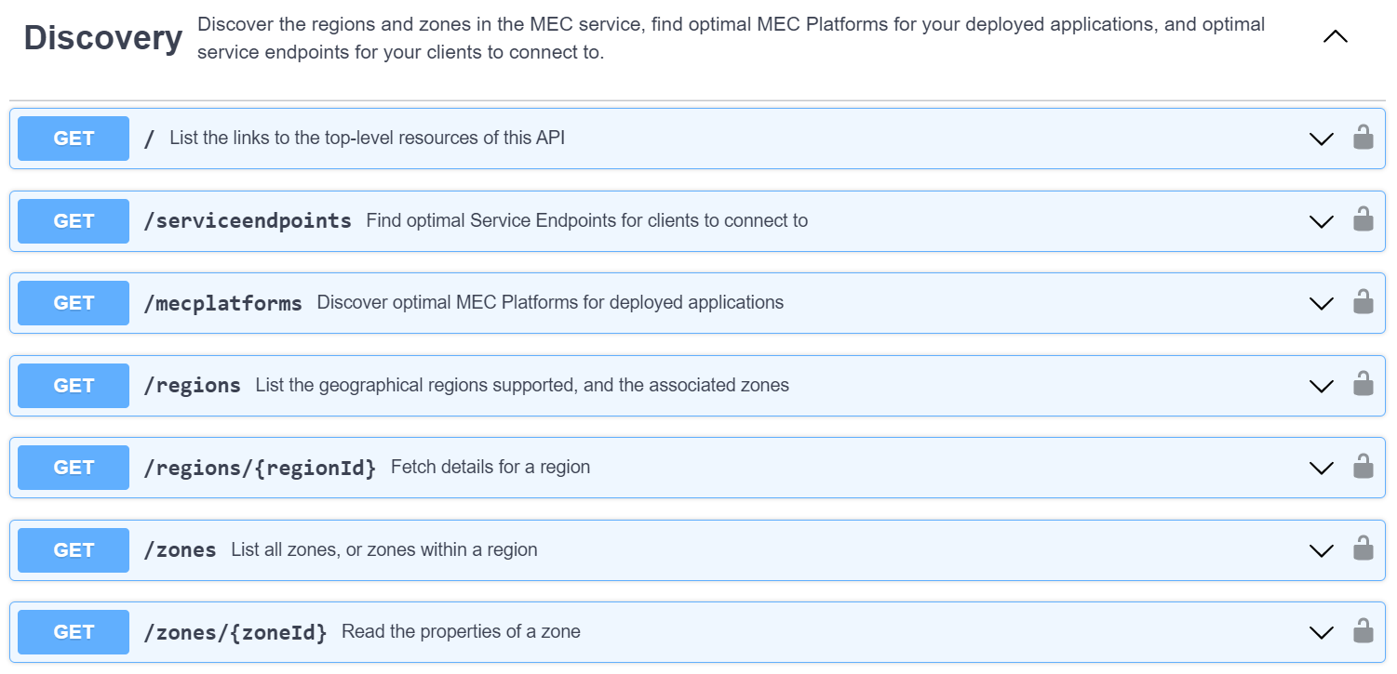
MEC Experience Management and Exposure - Discovery
Notes:
Registrar un perfil de servicio (una descripción del servicio de edge del desarrollador) con el operador MEC.
Registrar los endpoints de servicio desplegados con el operador MEC, lo que permite descubrir el endpoint de servicio más cercano en tiempo de ejecución.

Slide 6
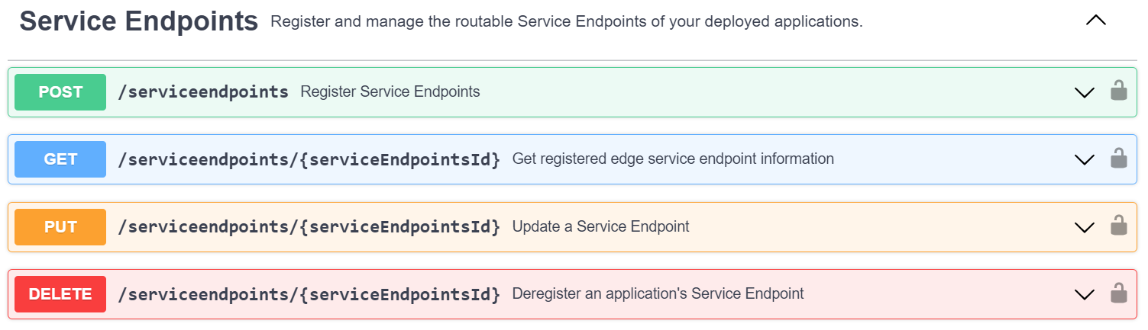
MEC Experience Management and Exposure – Service Endpoints

Slide 7
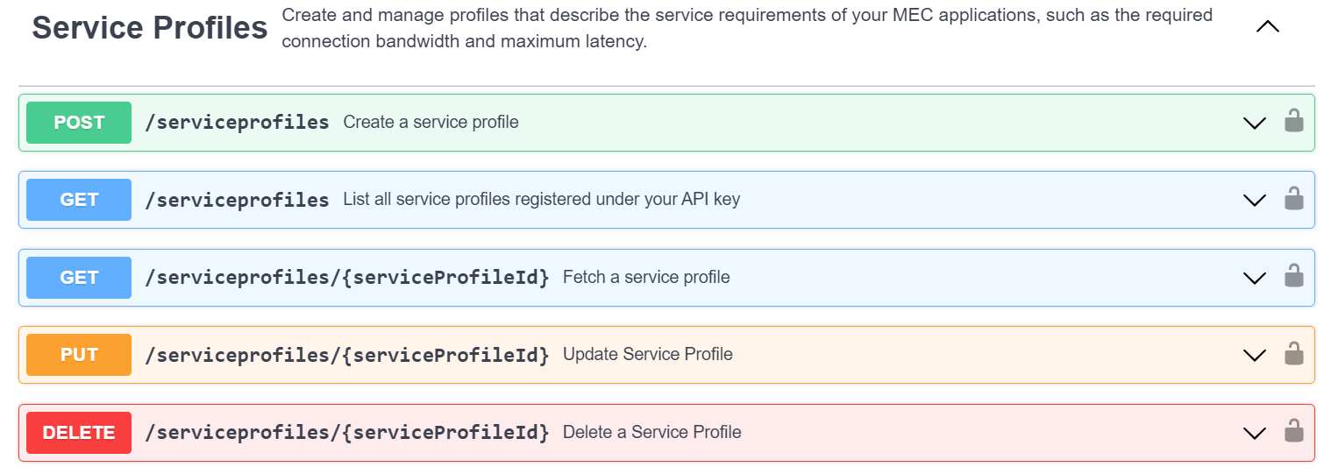
MEC Experience Management and Exposure – Service Profiles

Slide 8
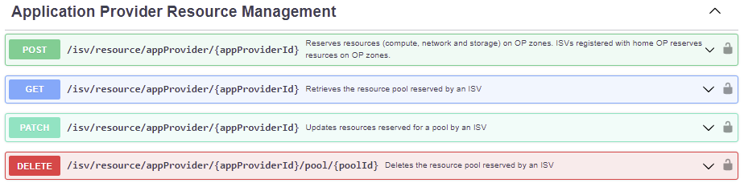
MEC Edge Cloud API
reserveComputeResources Reserves compute, network and storage resources on specified zones for an application provider
updateResourceReservation Updates (add, remove or change amount) resources reserved for an application provider
viewReservedResources Retrieves resources reserved for an application provider
removeReservedResources Remove resources reserved for an application provider

Slide 9
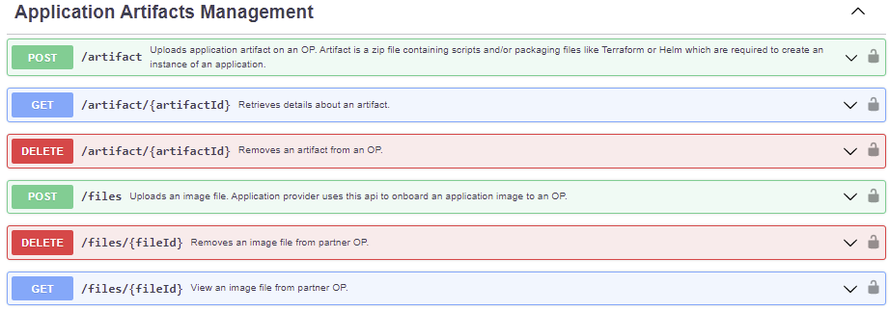
MEC Edge Cloud API
onboardArtifact Submits an artifact to operator platform
removeArtifact Removes an artifact from operator platform
viewArtifact Retrieves an artifact details
uploadFile Upload application binaries to operator platform
removeFile Removes application binaries from operator platform
viewFileInfo Retrieves details about binaries assosiated with an application

Slide 10
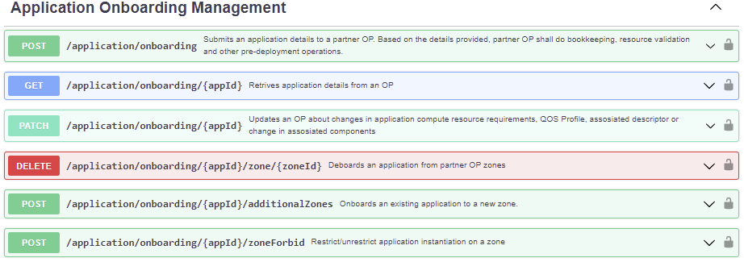
MEC Edge Cloud API
onboardApplication - Submits an application details to an OP. Based on the details provided, OP shall do bookkeeping, resource validation and other pre-deployment operations.
updateApplication - Updates an OP about changes in application compute resource requirements, QOS Profile, assosiated descriptor or change in assosiated components
removeApplication - Removes an application from an OP
viewApplication - Retrives application details from an OP
onboardExistingAppNewZones - Make an application available on new additional zones
lockUnlockApplicationZone - Forbid or permit intantiation of application on a zone

Slide 11
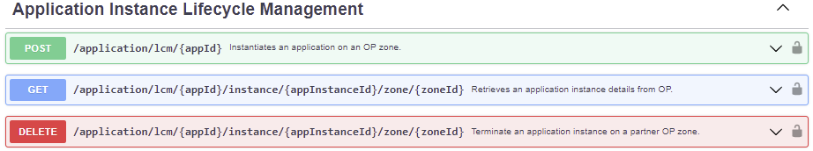
MEC Edge Cloud API
instantiateApplication - Submits an application details to an OP. Based on the details provided, OP shall do bookkeeping, resource validation and other pre-deployment operations.
viewApplicationInstance - Retrives details of an application instance running on a zone
removeApplication - Removes an application instance from an OP

